Slide 1

ACTUALITZACIÓ
INSUFICIÈNCIA CARDÍACA CRÒNICA
Mar Domingo
Unitat d’IC Hospital Universitari Germans Trias i Pujol
Servei d’Atenció Primària Badalona-Sant Adrià Besós
Grup de Malalties del Cor CAMFiC

Slide 2
De què parlarem?
Història natural de la malaltia:
És segur suspendre el tractament de la IC?
Evolució FEVE a llarg plaç?
Tractament farmacologic:
Diürètics:
Document de consens
És segur suspendre’ls?
Sacubitril/Valsartan:
    Subestudi reducción diürètics
Subestudi renal
Subestudi en diabètics
iSGLT2:
Tercer estudi CV, dapagliflozina
Vida real: iSGT2 vs iDPP4

Slide 3
Analitzar si és segur suspender el tractament de la IC en pacients assimptomàtics que han recuperat la FE.
51p. MCD no isquèmica amb FEVE<40% prèvia
Recuperació:
LVEF>50%
Normal LVEDVi
NT-pro-BNP <250ng/L
NYHA I
Screening visit
Clinical assessment, symptom questionnaires, NT-pro-BNP, CMR, CPET
Mimic what happens in clinical practice
Randomisation 1 to 1
Reduce/stop loop diuretics
Clinic review every 4 weeks
Clinical assessment and NT-pro-BNP
Interim telephone review
Reduce/stop MRAs
Clinic visit at 8 weeks
Clinical assessment and NT-pro-BNP
Continued therapy
Reduce/stop beta-blockers
Randomised
phase
Reduce/stop ACE inhibitors or ARB
16 week follow-up visit
Clinical assessment, NT-pro-BNP, CMR
6 month follow-up visit
Clinical assessment, symptom questionnaires, NT-pro-BNP, CMR, CPET
Single arm cross-over phase
Therapy withdrawal using the same protocol
Damman K et al. JACC Heart Fail. 2018 489-498.
Notes:
Patients initially stopped or reduced the dose of loop diuretic, followed by MRA, beta-blocker, and finally ACE inhibitor or ARB. If the patient was taking the equivalent of, or less than 40 mg of frusemide or 50 mg of spironolactone, or 25% or less of the maximum
recommended dose of beta-blocker, ACE inhibitor, or ARB, the medication was stopped. If the patient was taking a larger dose, this was reduced by 50% in a stepwise manner every 2 weeks
After 6 months, patients in the continued treatment group had treatment withdrawn by the same method. The primary endpoint was a relapse of dilated cardiomyopathy within 6 months, defined by a reduction in LVEF of more than 10% and to less than 50%, an increase in LVEDV by more than 10% and to higher than the normal range, a two-fold rise in NT-pro-BNP concentration and to more than 400 ng/L, or clinical evidence of heart failure, at which point treatments were re-established.

Slide 4
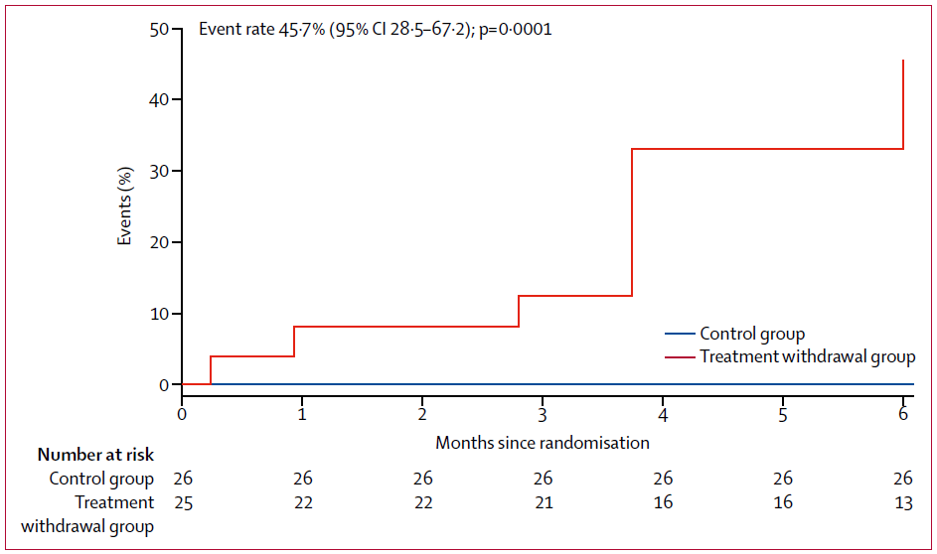
Damman K et al. JACC Heart Fail. 2018 Jun;6(6):489-498.
RESULTATS
Median age: 55 years (IQR 45 to 64). 34 (67%) men
At first diagnosis
  Median LVEF: 25% (IQR 20 to 33)
  Median time from diagnosis: 4.9 yrs (IQR: 2.1 to 8.3)
At enrolment
  All in sinus rhythm
  Median LVEF: 60% (IQR 55 to 64)
  Median NT-pro-BNP: 72ng/L (IQR 39 to 135)
All patients on ACEi/ARB
45 (88%) on beta-blocker
24 (47%) on MRA
6 (12%) on loop diuretic
1 pt had CRT-D and 1 pt an ICD in situ
Endpoint primari:
Recaiguda de miocardiopatia:
*Caiguda FEVE>10% quedant FEVE<50%
* Increment VTDVE > 10%
* Augment x2 NTproBNP fins a >400ng/L
*IC clínica
El 40% dels pacients van presentar l’end point primary
Només el 50% dels pacients van completar l’estudi sense haver de reiniciar el tractament
Until robust predictors of relapse are defined, treatment should continue indefinitely.
Notes:
Withdrawal of pharmacological heart failure therapy from patients deemed to have recovered DCM resulted in relapse in ~40% of cases
Likely to be greater in medium- and long-term
Withdrawal of therapy should not usually be attempted, until
Predictors of relapse are defined
Better understanding of importance of specific therapies
Monitoring in place
Improvement in function represents remission rather than permanent recovery for many patients

Slide 5
Analitzar el comportament de la FEVE a llarg plaç en pacients amb FEr i FEmr tractats segons les guíes de pràctica clínica
Estudi unicèntric 1160 pacients FEVE<49%
Seguiment amb ecocardiograma a 15 anys
Total de 4183 ecocardiogrames
J.Lupon et al. J Am Coll Cardiol. 2018 Aug 7;72(6):591-601.
Notes:
Follow-up visits included a minimum of 1 visit with a nurse every 3 months and 1 visit with a physician (cardiologist, internist, or family physician) every 6 months (Online Figure 1), as well as optional visits with specialists in geriatrics, psychiatry, and rehabilitation.

Slide 6
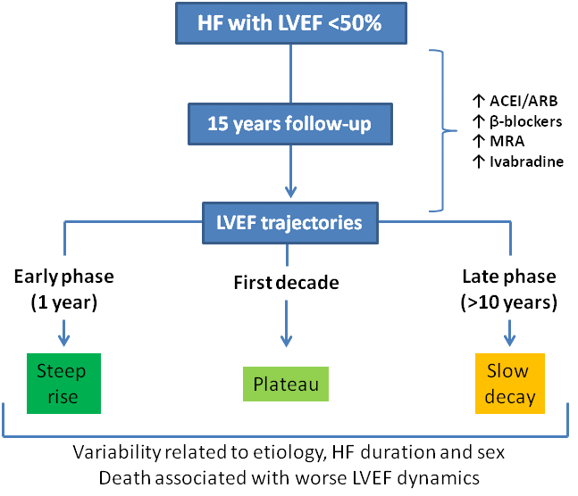
RESULTATS
72% mortalitat als 15 anys
J.Lupon et al. J Am Coll Cardiol. 2018 Aug 7;72(6):591-601.
Notes:
LVEF show a significant improvement at 1 year, with an LVEF rise up to a decade and a slow LVEF decline thereafter. Second, a declining LVEF in the preceding period is associated with higher mortality
.Malaltia crónica
Millora amb tractament específic

Slide 7
RESULTATS
Sexe
Duració de la IC
Etiologia isquèmica vs. no isquèmica
Notes:
LVEF trajectories are highly variable depending on etiology, HF duration at baseline visit, ESC classification, and sex
Sex: The exact mechanism underlying these differences is unclear, but sex-related differences in cardiac remodeling and the protective effects of estrogen against apoptosis could be among the explanations
A different pattern was observed for alcohol-related HF, which showed a continuous increase in LVEF to full recovery, thus suggesting that in the absence of alcohol consumption, discontinuation of treatment could be an option.
Whether the beneficial effects of ß-blockers and angiotensin-affecting drugs in reverse remodeling are partially lost in the long-term
because of a certain degree of drug resistance remains unclear. Nevertheless, clear guidance is lacking on what to do for patients who experience a decline in LVEF over time despite optimal medical treatment

Slide 8
Lupón et al. Circ Heart Fail. 2019;12:e005652. DOI: 10.1161/CIRCHEARTFAILURE.118.005652

Slide 9
De què parlarem?
Història natural de la malaltia:
És segur suspendre el tractament de la IC?
Evolució FEVE a llarg plaç?
Tractament farmacologic:
Diürètics:
Document de consens
És segur suspendre’ls?
Sacubitril/Valsartan:
    Subestudi reducción diürètics
Subestudi renal
Subestudi en diabètics
iSGLT2:
Tercer estudi CV, dapagliflozina
Vida real: iSGT2 vs iDPP4

Slide 10
DETECCIÓ DE LA CONGESTIÓ: sense gold standar
Paràmetres clínic +/- radiografía tòrax +/- biomarcadors (PN, CA125…)
Mètodes no invasius: ecografía (ETT, vena cava inferior, ecografía pulmó)
Mullens et al. Eur J Heart Fail 2019. doi:10.1002/ejhf.1369.
Notes:
El documento aborda los temas principales que suponen un reto habitual en el manejo práctico de la IC congestiva y que comentaré, por su extensión e interés, en dos partes. La primera está enfocada en la definición y detección de congestión, así como la respuesta y resistencia a diuréticos. Y la segunda, al uso práctico de diuréticos en IC aguda y en la IC crónica.
De entre los parámetros clínicos, sin que ninguno de ellos de forma aislada sea un fuerte predictor de congestión, la presión venosa yugular destaca como de los más útiles.
Dentro de los parámetros de imagen, los ecocardiográficos pueden ser de ayuda para la estimación de presiones intracavitarias derechas (colapsabilidad de vena cava) e izquierdas (estudio con Doppler tisular: tiempo de desaceleración onda e< 130 ms, relación e/e´> 12, entre otros). Destaca también como método que está adquiriendo protagonismo en los últimos años, la identificación de líneas B en la ecografía

Slide 11
TRACTAMENT DE LA ICA

Slide 12
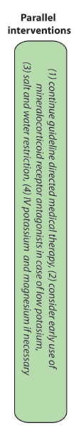
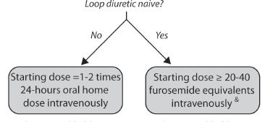
IRC?

Slide 13
TRACTAMENT DE LA ICC
The effects of diuretics in chronic heart failure on morbidity and mortality have not been studied in large prospective randomized controlled trials. Class I
It is generally advised to use to the lowest possible dose of diuretics and the dose of the loop diuretic often needs to be adjusted to the individual need.
Importantly, the individual diuretic need significantly changes over time.
Uncertainty exists about the optimal dose of loop diuretics following discharge. For patients who developed an acute heart failure episode while previously taking a loop diuretic before admission, a higher dose following discharge might need to be used.
Additionally, in case that this previous loop diuretic was furosemide, a switch to either bumetanide or torsemide might be considered, as they have a more predictable absorption pattern and bioavailability, especially in the face of subclinical congestion.
The chronic use of thiazides in the stable ambulatory setting (sequential nephron blocking) should be avoided, if possible, as this practice often induces severe electrolyte disturbances that could go undetected in the ambulatory setting.

Slide 14
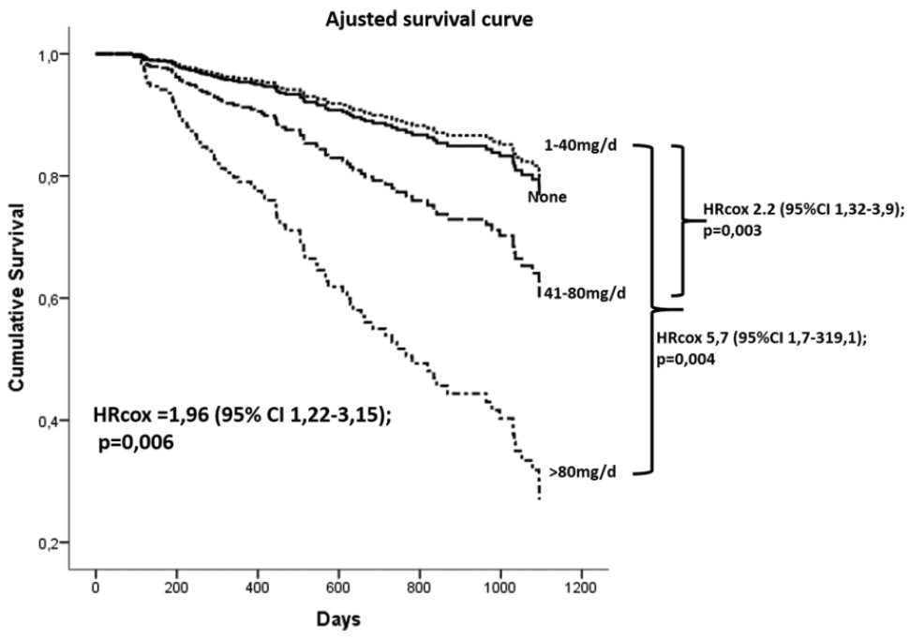
IMPORTÀNCIA DE LA DOSIS DE DIÜRÈTICS
La dosis de furosemida pot identificar pitjor pronòstic
Sargento L. J Cardiovasc Pharmacol Ther 2017; 22(3):256-263.
En pacients sense signes de congestió, la dosis de diuretic pot impactor en el pronòstic
* HipoTA i l’empitjorament F renal limiten l’optimització del tractament (SRRA)
* Deplecció intravascular activa secreció renina
Beygui et al. Heart Fail Rev (2015) 20:545–552

Slide 15
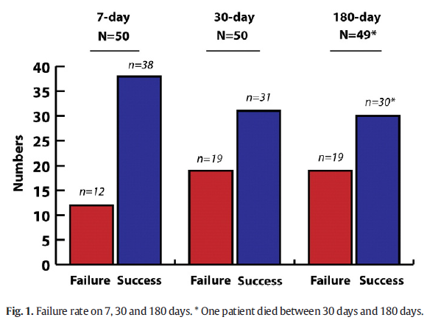
Avaluar si és viable reduir la dosis de diuretic.
50 pacients amb tractament mèdic óptim i sense signes de congestió (al menys 3 mesos sense descompensació)
La dosis de manteniment dels diürètics de nansa es va reduir succesivament al 50% o va ser retirada si la dosis era ≤ 40 mg de furosemida o equivalent.
L’èxit de reducció de dosis va ser definit com la reducció persistent de dosis als 30 dies sense increment de pes > 1.5 kg ni símptomes d’empitjorament de la IC
Als 30 díes de seguiment, l’èxit en la reducció de dosis es va produir en el 62% dels pacients
Failure rate on 7, 30 and 180 days.
Martens P et al. Int J Cardiol. 2018 Jan 1;250:171-175

Slide 16
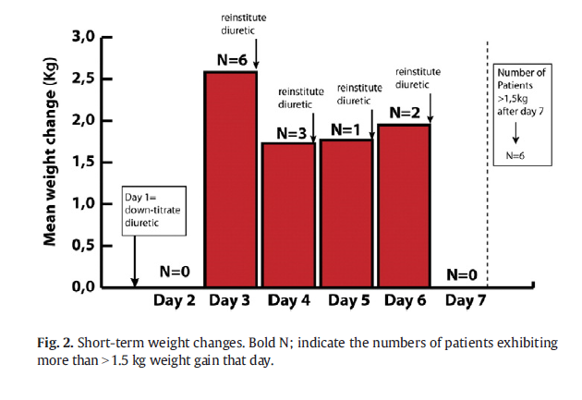
Canvis de pes a curt plaç
La major part dels increments de pes > 1,5 kg (12 de 50 pacients), van aparèixer en les primeres 72 h.
Cap cas de descompensació per IC
Martens P et al. Int J Cardiol. 2018 Jan 1;250:171-175

Slide 17
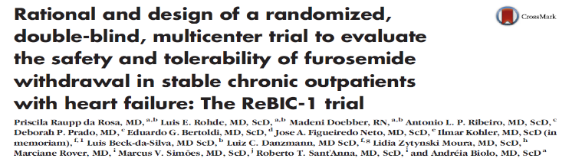
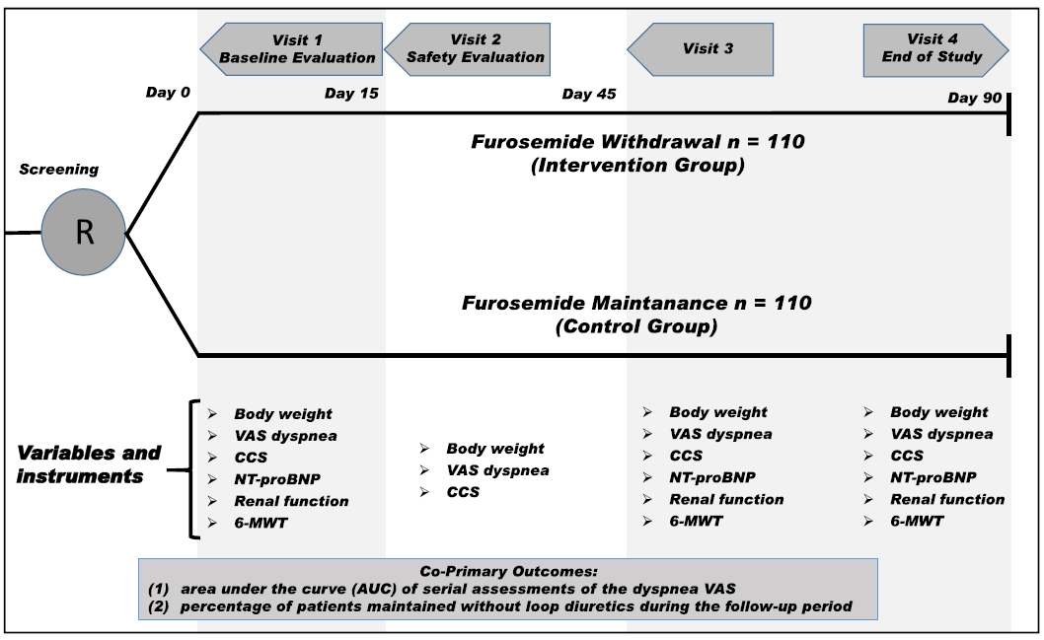
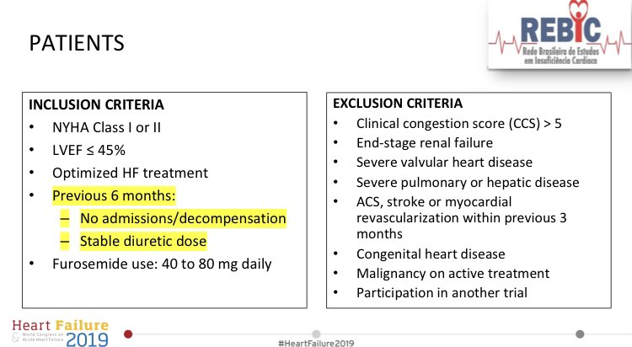
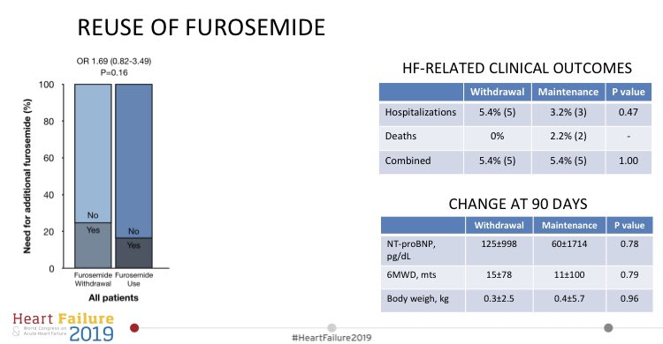

Slide 18
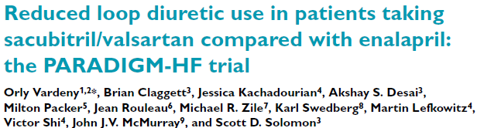
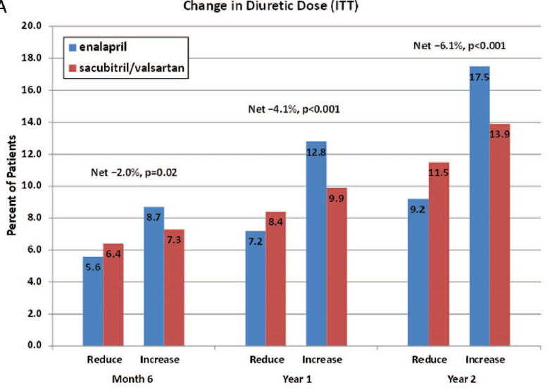
Comparar les dosis de diürètic entre els pacients tractats amb ARNI I els tractats amb Enalapril
8399 pacients randomitzats a sacubitril/valsartan 200 mg x2 o enalapril 10mg x2
Els pacients amb dosis més altes de diuretic tenien pitjor CF, més hospitalitzacions prèvies, pitjor Fg i > NT proBNP
Vardeny et al. European Journal of Heart Failure (2019);21: 337–341

Slide 19
Comparar les dosis de diürètic entre els pacients tractats amb ARNI I els tractats amb Enalapril
8399 pacients randomitzats a sacubitril/valsartan 200 mg x2 o enalapril 10mg x2
Els pacients amb dosis més altes de diuretic tenien pitjor CF, més hospitalitzacions prèvies, pitjor Fg i > NT proBNP
Vardeny et al. European Journal of Heart Failure (2019);21: 337–341
Notes:
The reduced relative need for diuretics in patients randomized to sacubitril/valsartan may potentially be secondary to the natriuretic effects of sacubitril or the presumed improvement in haemodynamics that may occur with sacubitril/valsartan
Limitations:
was not a pre-specified analysis
Doses of diuretics were not available for all participants, which could lower the precision of dose change comparisons between groups.
Diuretic dose changes were not available at earlier time points after randomization, which could have been of interest given the quick onset of NT-proBNP reduction by sacubitril/valsartan.
Additionally, there was limited information on medication dose changes during the run-in period of
the PARADIGM-HF trial; these data could have further informed trends on diuretic dose adjustments after initiation of sacubitril/ valsartan.
Reasons for diuretic dose changes were not captured in the study.
Lastly, there could be incomplete capture of non-loop diuretic changes or addition of MRAs.

Slide 20
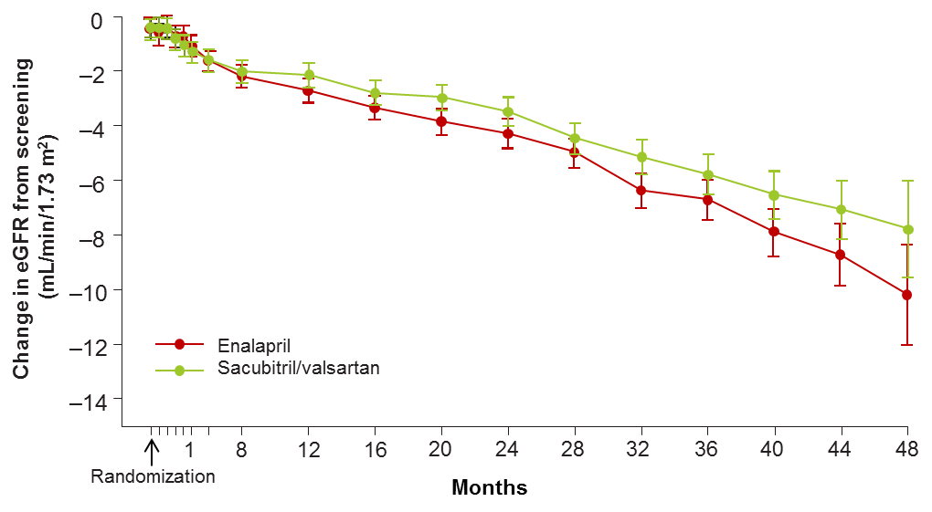
Avaluar els efectes renals dels ARNI
8399 pacients randomitzats a sacubitril/valsartan 200 mg x2 o enalapril 10mg x2
33% pacients amb FG<60 (49±8) dels que 39% eren DM I 78% HTA. 100% IECA/ARA, 85% diür 52% ARM
Pacients amb MRC
HR: 0.79; 95% CI: 0.69 - 0.90
Pacients sense MRC
HR: 0.81; 95% CI: 0.73 to 0.91
p d’interacció =0.70
Deteriorament de la TFGe des del valor basal
fin el mes 48
Sacubitrilo/valsartán: HR 7.8 (95% CI 9.6─6.0)
Enalapril: HR 10.2 (95% CI 12.1─8.3)
Dammam et al. J A C C HF. 2 0 1 8 : 4 8 9 – 9 8

Slide 21
CONCLUSIONS Compared with enalapril, sacubitril/valsartan led to a slower rate of decrease in the eGFR and improved cardiovascular outcomes, even in patients with chronic kidney disease, despite causing a modest increase in UACR.
(tot i mes hipoTA). Mecanisme ?
Dammam et al. J A C C HF. 2 0 1 8 : 4 8 9 – 9 8
Notes:
ALBUMINURIA: Por cada nivel de UACR en el mes 1 tras la randomización, la incidencia del endpoint primario (muerte CV o primera hospitalización) fue menor en el brazo de sacubitrilo/valsartan vs. enalapril
It was notable in the present study that the beneficial effect of sacubitril/valsartan on eGFR occurred despite a decrease in arterial pressure, a hemodynamic change usually leading to a decrease in the eGFR when it occurs in the setting of RAAS blockade
The mechanisms of relative preservation of eGFR with sacubitril/valsartan are therefore not clear, and might also just reflect improvement in heart failure status
The favorable effects of sacubitril/valsartan, compared with enalapril, on eGFR and these renal outcomes were similar in patients with baseline CKD, compared with those without CKD,
It is likely that the rapid onset and modest increase in UACR seen with sacubitril/valsartan, and that stabilizes after few weeks of treatment, reflects a distinct, and probably acute intrarenal hemodynamic effect, likely due to the actions of natriuretic peptides (and possibly other vasoactive substances catalyzed by neprilysin). The
possibilities include one or more of an increase in glomerular endothelial permeability and hydraulic conductivity, a direct effect on mesangial cells, or alterations in renal arteriolar tone
Other: when efferent arteriolar vasodilation has already been achieved by treatment with an inhibitor of the renin-angiotensin system, potentiation of endogenous natriuretic peptides would be expected to cause afferent arteriolar vasodilation, which would lead to further increases in intraglomerular pressures.
Such an action could explain the increase in albuminuria after sacubitril/valsartan treatment in the present study, but an increase in intraglomerular pressures produced by natriuretic peptides would be expected to adversely affect the course of renal disease, particularly in patients with diabetes. Yet, in the current study, the opposite outcome was notED

Slide 22
SENSE DM
AMB DM
La magnitud del benefici de sacubitrilo/valsartán vs. enalapril sobre la funció renal en pacients amb DM2 va ser el doble que en pacients sense DM2
Packer M. et al., Lancet, Diabetes&Endocrinology 2018
Notes:
The progression of renal disease in diabetes is thought to be a consequence of glomerular hyperfiltration. If glomerular hypertension is related to an imbalance in the tone of afferent and efferent arterioles, then an intervention that causes afferent arteriolar vasoconstriction or efferent arteriolar vasodilation might be expected to reduce intraglomerular pressures and attenuate renal injury.
However, when efferent arteriolar vasodilation has already been achieved by treatment with an inhibitor of the renin-angiotensin system, potentiation of endogenous natriuretic peptides would be expected to cause afferent arteriolar vasodilation, which would lead to further increases in intraglomerular pressures.
Such an action could explain the increase in albuminuria after sacubitril/valsartan treatment in the present study, but an increase in intraglomerular pressures produced by natriuretic peptides would be expected to adversely affect the course of renal disease, particularly in patients with diabetes. Yet, in the current study, the opposite outcome was notED

Slide 23
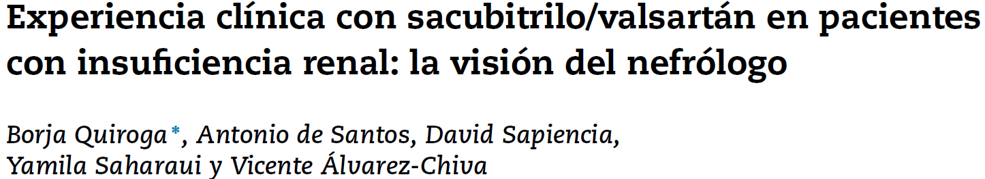
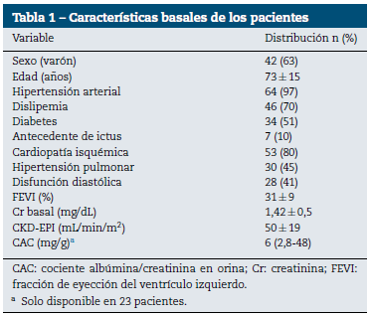
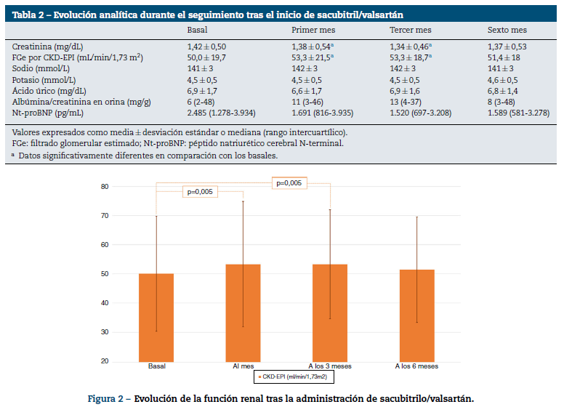
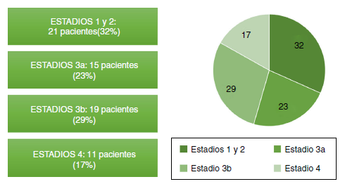

Slide 24
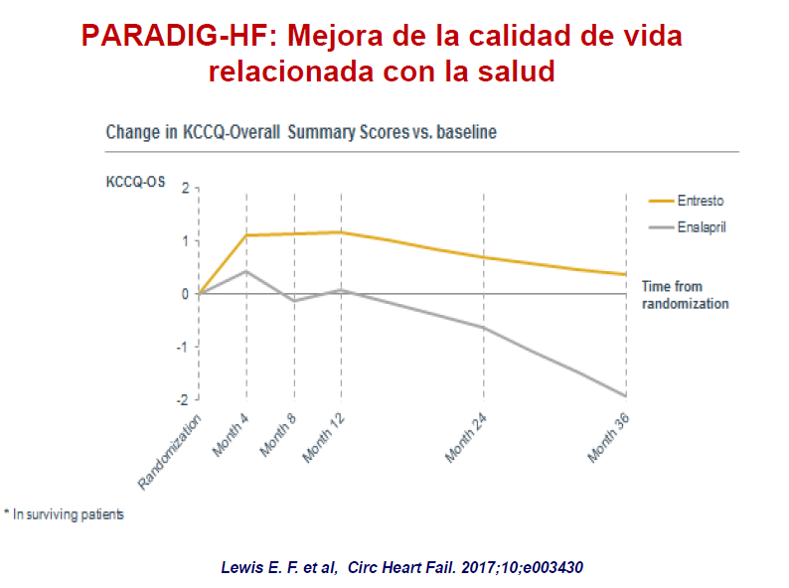

Slide 25
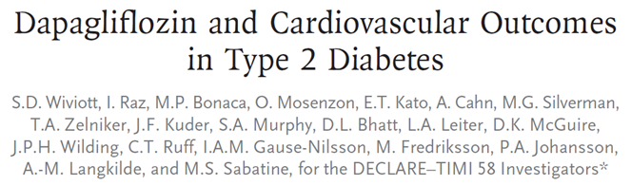
Características basales | DAPA 10 mg (N=8582) | Placeboª (N=8578)
Edad media, años | 63.9 | 64.0
Sexo, n (%)
Hombre | 5411 (63.1) | 5327 (62.1)
Mujer | 3171 (36.9) | 3251 (37.9)
Raza, n (%)
Blanca | 6843 (79.7) | 6810 (79.4)
Negra o afroamericana | 295 (3.4) | 308 (3.6)
Asiática | 1148 (13.4) | 1155 (13.5)
Otra | 296 (3.4) | 305 (3.6)
HbA1c media, % | 8.3 | 8.3
Duración media de DM2, años | 11.0 | 10.0
IMC medio, kg/m² | 32.1 | 32.0
Presión arterial sistólica media, mmHg | 135.1 | 134.8
TFGe medio, mL/min/1.73 m² | 85.4 | 85.1
Categoría de riesgo CV basal
Pacientes con MFRCV | 5108 (59.5) | 5078 (59.2)
Patientes con ECV | 3474 (40.5) | 3500 (40.8)
Historia de insuficiencia cardiaca | 852 (9.9) | 872 (10.2)
Tratamiento antihiperglucemiante
Metformina | 7020 (81.8) | 7048 (82.2)
Sulfonilureas | 3615 (42.1) | 3707 (43.2)
Inhibidores de DPP-4 | 1418 (16.5) | 1470 (17.1)
Insulina | 3567 (41.6) | 3446 (40.2)
Agonistas receptor GLP-1 | 397 (4.6) | 353 (4.1)
Tratamiento CV farmacológico
iECA o ARA-II | 6977 (81.3) | 6973 (81.3)
Betabloqueantes | 4498 (52.4) | 4532 (52.8)
Diuréticos | 3488 (40.6) | 3479 (40.6)
Estatina o ezetimiba | 6432 (74.9) | 6436 (75.0)
Antiagregantes | 5245 (61.1) | 5242 (61.1)
17,160 pacientes con DM2
con enfermedad CV (6,974) o
múltiples factores de riesgo CV (10,186)
Criterios de elegibilidad
Diagnóstico de DM2, HbA1c 6.5-12%, ClCr ≥ 60 mL/min
Enfermedad cardiovascular aterosclerótica establecida (≥ 40 años) O
Múltiples factores de riesgo cardiovascular (Hombres ≥ 55 años y mujeres ≥ 60 años con al menos un FRCV adicional)
ALEATORIZACIÓN 1:1
DOBLE CIEGO
En adición al tratamiento de base de los pacientes
Dapagliflozina 10 mg QD
Placebo
QD
Condicionado por eventos: >1390 MACE
Visitas de seguimiento:
Telefónicas cada 3 meses
Presenciales cada 6 meses
Mediana de seguimiento:
4,2 años
Objetivos primarios del estudio
MACE (IM no mortal, ictus no mortal, muerte CV)
hIC/muerte CV
Wiviott SD et al. N Engl J Med. 2019 Jan 24;380(4):347-357.

Slide 26
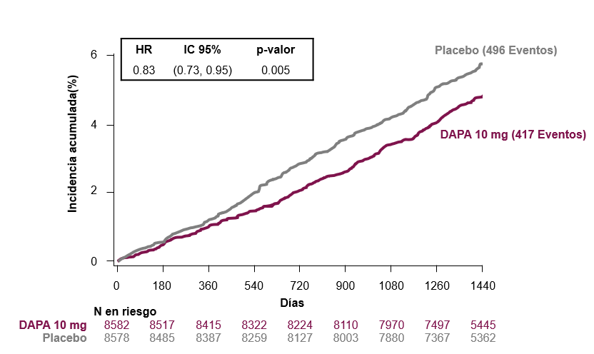
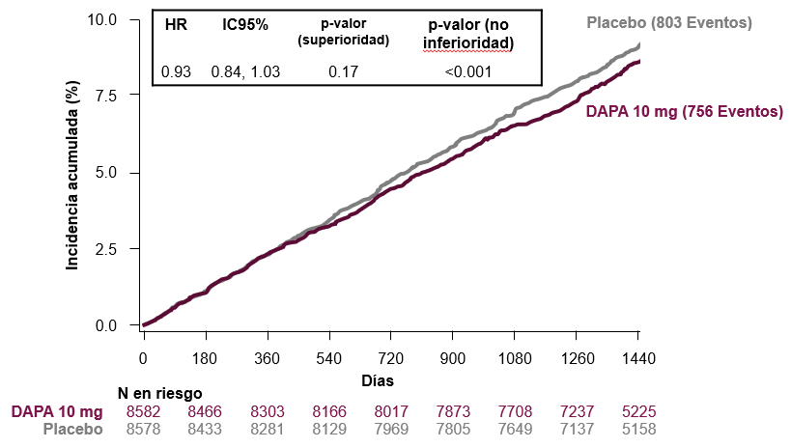
Variable hIC/Muerte CV
MACE
(para superioridad)
  Este efecto fue independiente de la historia previa de enfermedad CV o IC
  Dapagliflozina redujo ~ 27% de RRR en la hIC en una población en la que la mayoría de pacientes no tenía antecedentes de insuficiencia cardiaca.
Se observaron menos eventos MACE en pacientes que recibieron dapagliflozina respecto a los que recibieron placebo, aunque sin significación estadística
MACE (IM no mortal, ictus no mortal, muerte CV)
Wiviott SD et al. N Engl J Med. 2019 Jan 24;380(4):347-357.

Slide 27
Zelniker TA et al. Lancet Jan 5;393(10166):31-39.

Slide 28
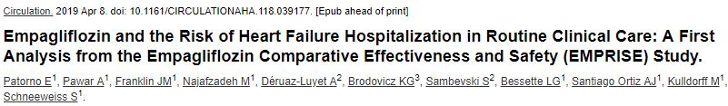
We investigated the risk of HHF among T2D patients initiating empagliflozin vs. sitagliptin, a dipeptidyl peptidase-4 inhibitor (DPP-4i).
Two commercial and one federal (Medicare) claims data sources in the U.S., we identified a 1:1 propensity-score (PS) matched cohort of T2D patients ≥18 years initiating empagliflozin or sitagliptin from 08/2014 through 09/2016.
The HHF outcome was defined as a HF discharge diagnosis in the primary position (HHF-specific); a broader definition was based on a HF discharge diagnosis in any position (HHF-broad).

Slide 29
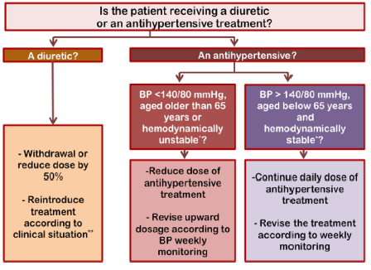
XVIII JORNADES D’ACTUALITZACIÓ TERAPÈUTICA 2018
Diabetes Ther DOI 10.1007/s13300-017-0277-0

Slide 30
IDEES CLAU
Recidiva de la miocardiopatia al retirar el tractament en IC “recuperada” (TRED-HF)
Trajectories de la fracció d’ejecció a 15 anys
* FEVEr a llarg plaç morfologia U invertida
* FEVEp a llarg plaç no empitjoren la FEVE
Diürètics
* Document consens diürètics: algorisme de tractament de la ICA “adaptable” a l’entorn ambulartori. Pautes en tractament IC crònica
* És possible reduir diürètics però no tenim cap paràmetre predictiu de l’èxit
Sacubitril-Valsartan
    * Major reducción de dosis de diürètic vs Enalapril
    * Menys deteriorament de la funció renal en pacients amb/sense IRC vs Enalapril
    * Menys deteriorament de la funció renal en pacients amb/sense DM vs Enalapril
iSGLT2:
* Dapagliflozina tercer iSGLT2 amb reducció d’ingrés per IC (DECLARE)
* Dades en vida real amb >>> reducción hospitalitzacions IC dels iSGLT2 vs iDPP4

